Slide 1


Physics-grounded Differentiable Simulation for Soft Growing Robots
Lucas Chen, Yitian Gao, Sicheng Wang, Francesco Fuentes, Laura H. Blumenschein, Zachary Kingston
commalab.org

Slide 2
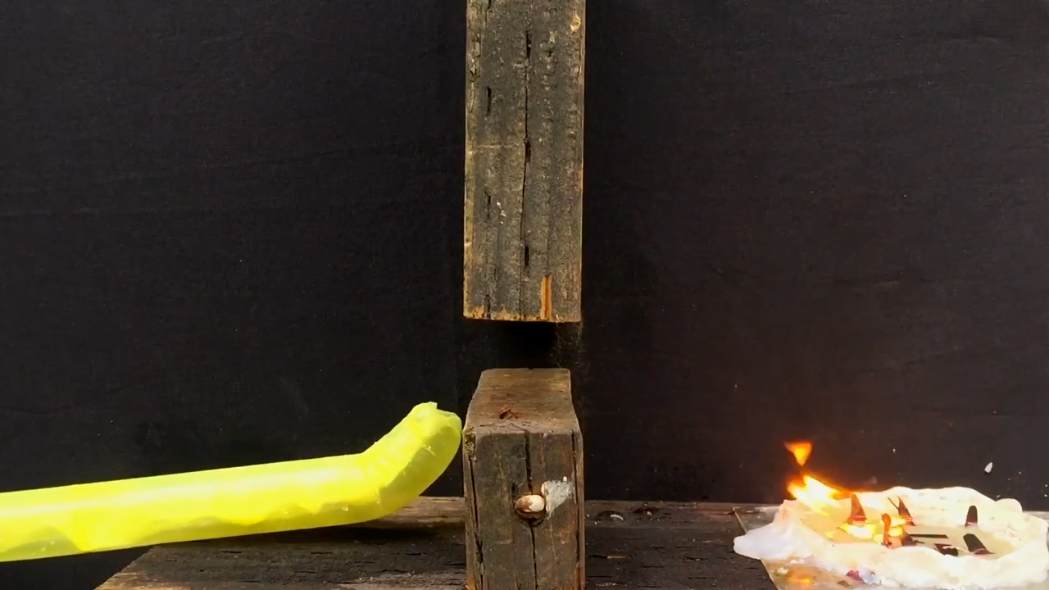
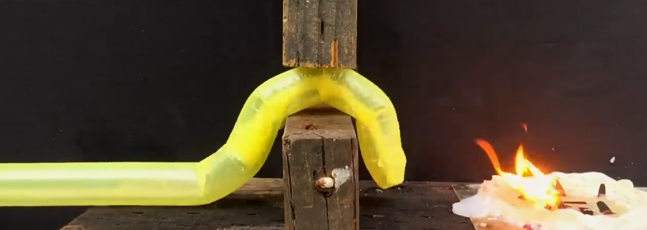
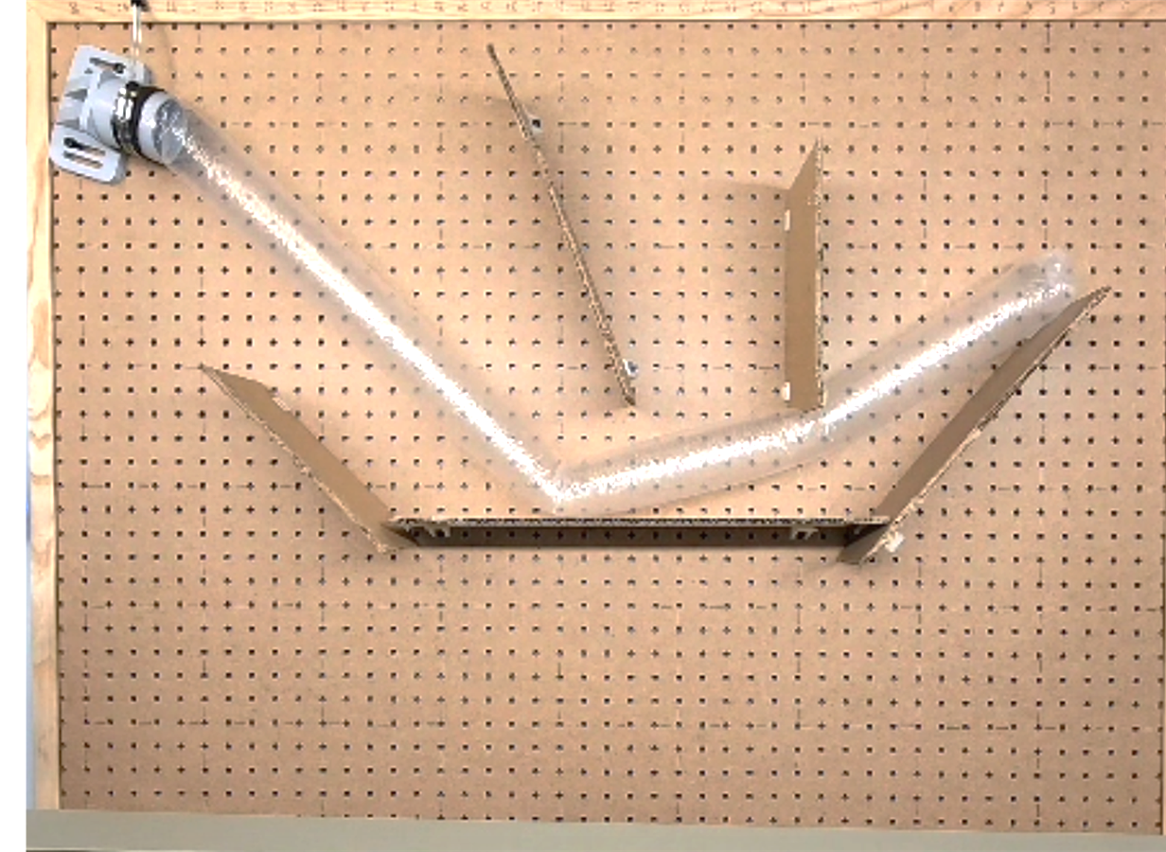
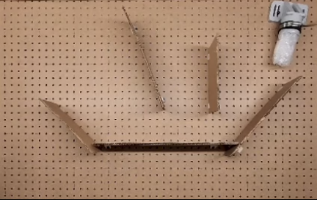
Introduction
Vine robots grow by inflating
Can collide with obstacles
Useful in cluttered environments
We want to model its compliant behavior, but it’s really hard!
news.stanford.edu/stories/2017/07/stanford-researchers-develop-new-type-soft-growing-robot
Notes:
video for the bottom image

Slide 3
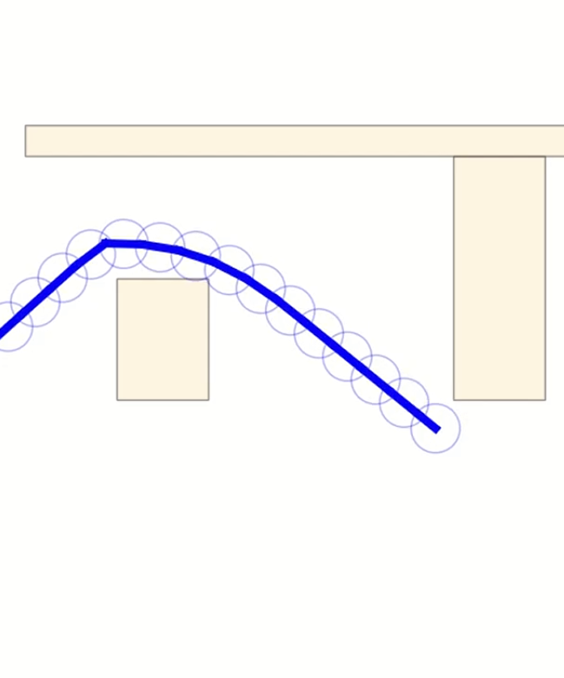
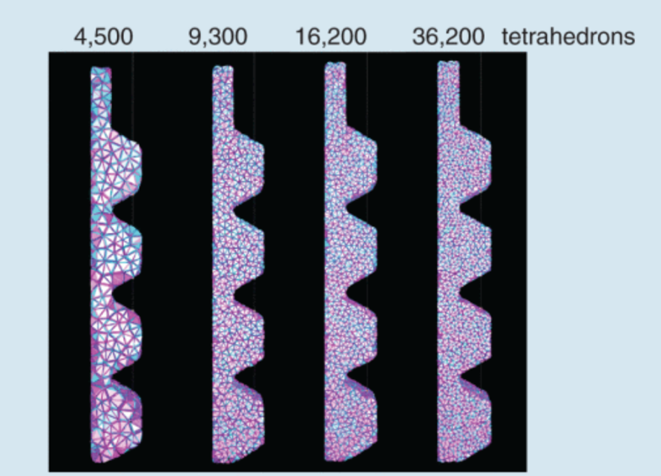
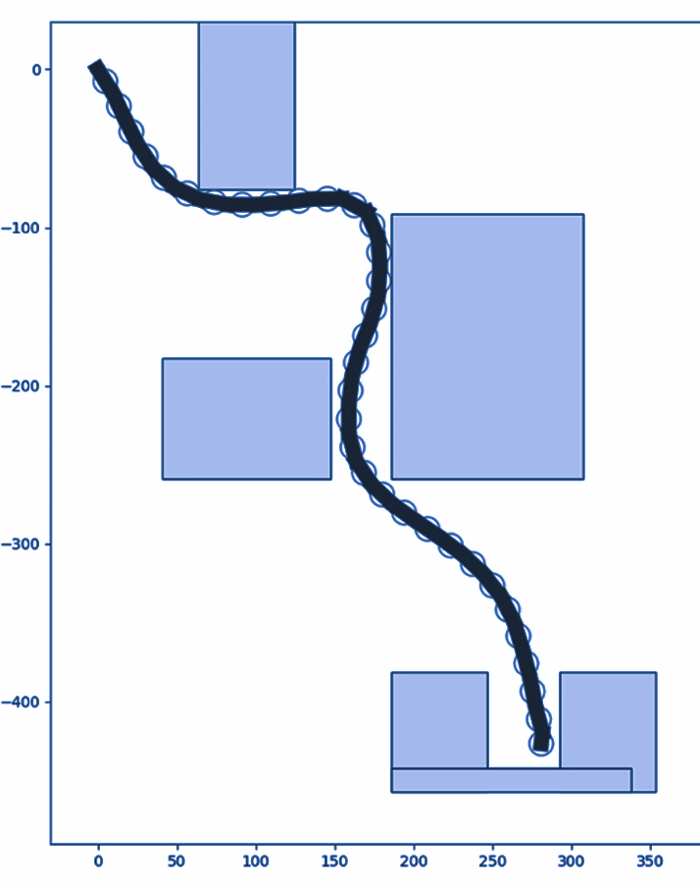
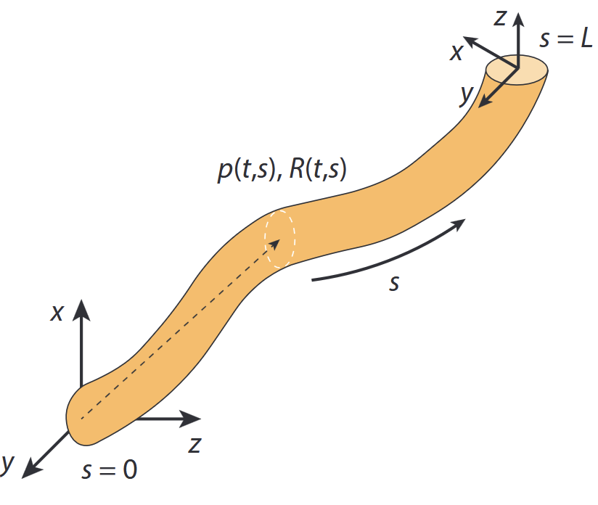
Past simulators
Finite Element models are very accurate but too slow
Analytic models are simplified and do not account for contacts or dynamics
Rigid body models are fast and have contact interactions but still inaccurate
FEM: P. Ferrentino, et al. "Finite Element Analysis-Based Soft Robotic Modeling: Simulating a Soft Actuator in SOFA," in IEEE Robotics & Automation Magazine, vol. 31, no. 3, pp. 97-105, Sept. 2024
Analytic: Yasa, Oncay, et al. "An overview of soft robotics." Annual Review of Control, Robotics, and Autonomous Systems 6.1 (2023): 1-29.

Slide 4
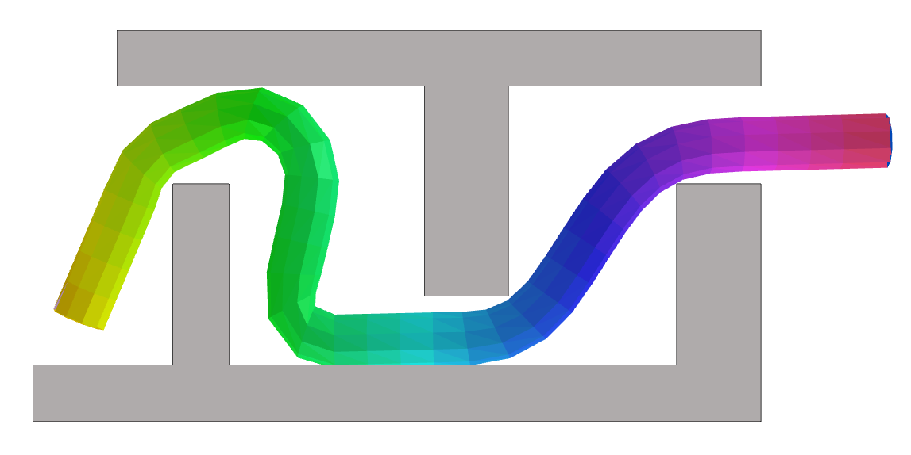
Contribution
Fast rigid body approach
Custom nonlinear stiffness function
Differentiable QP solver
Supports parameter fitting
Batchable

Slide 5
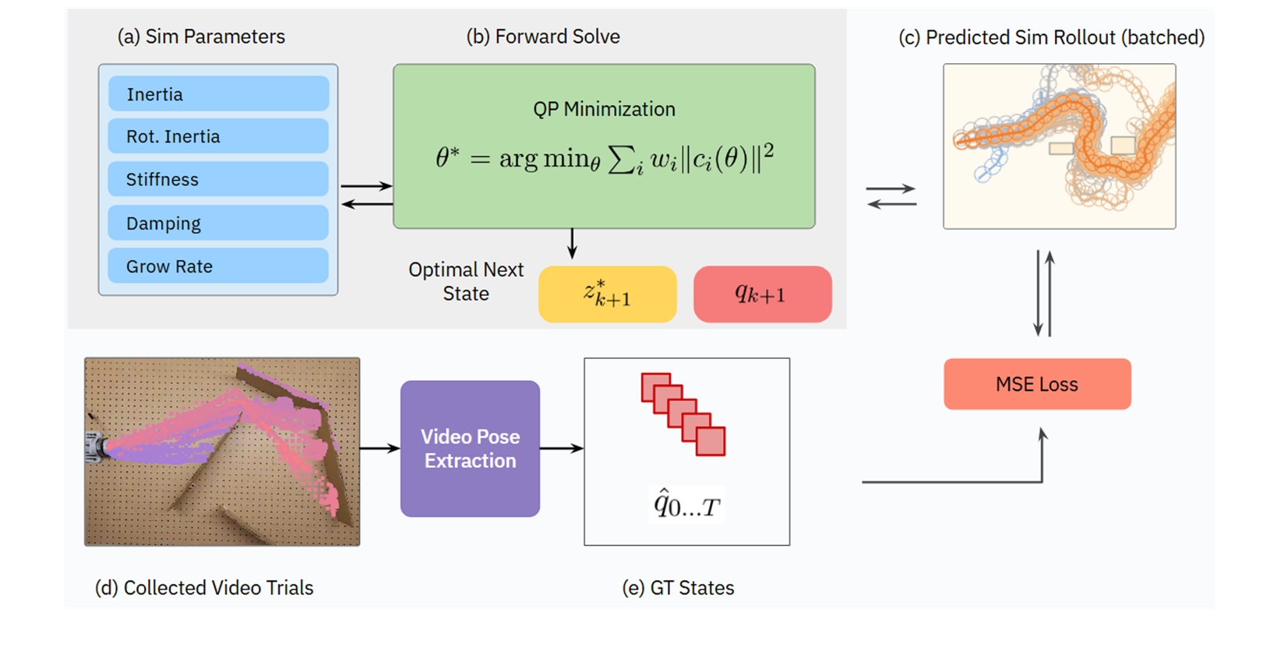
Pipeline
Notes:
In our simulation framework, we compute the next feasible position for our vine using a QP solver, which we will describe in the next slide.
This is part of our parameter fitting algorithm, which iteratively finds the optimal parameters to match observed behavior of vines.

Slide 6
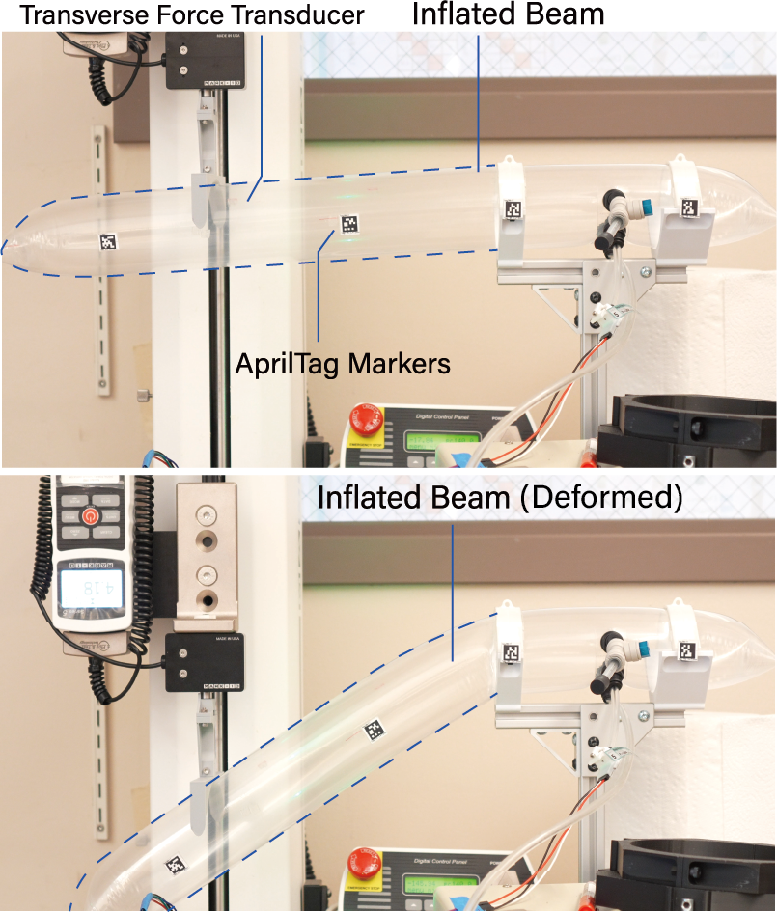
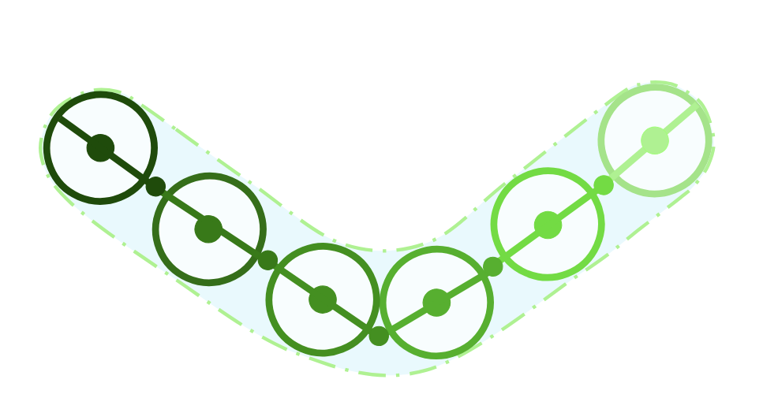
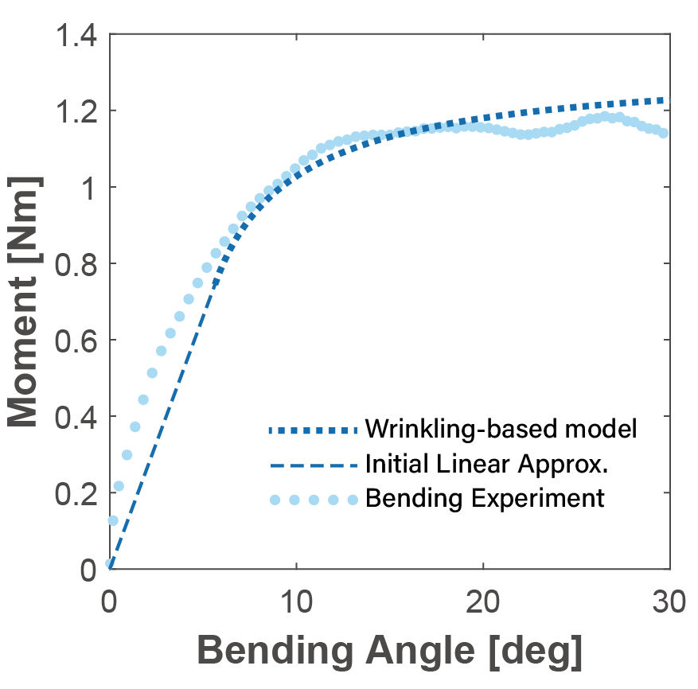
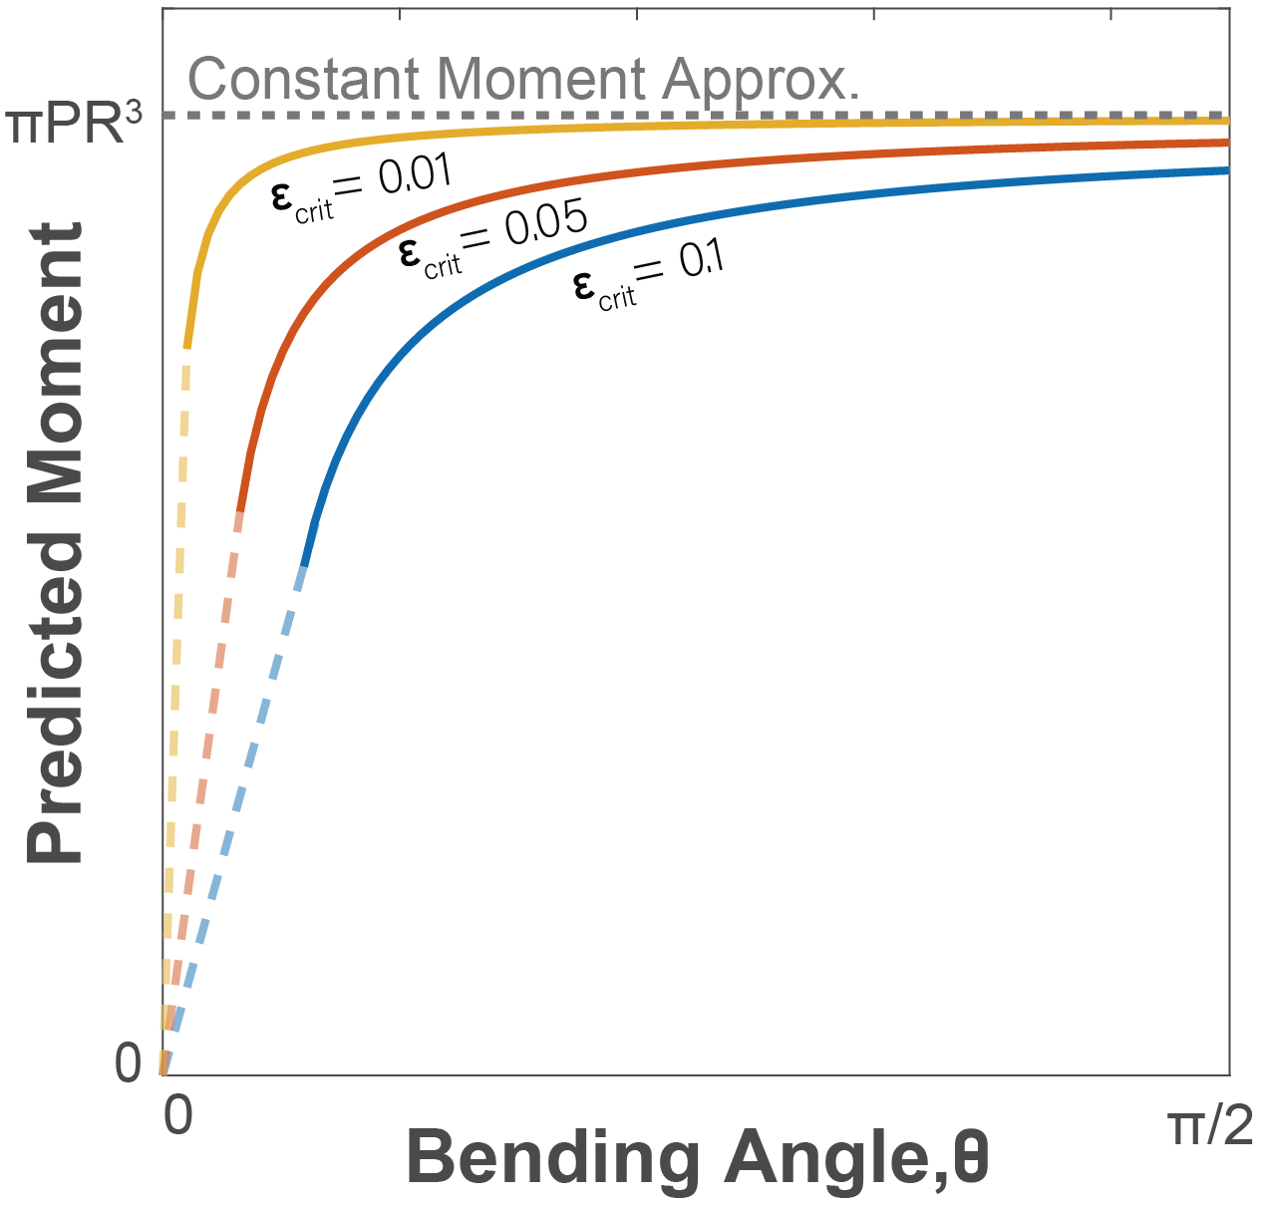
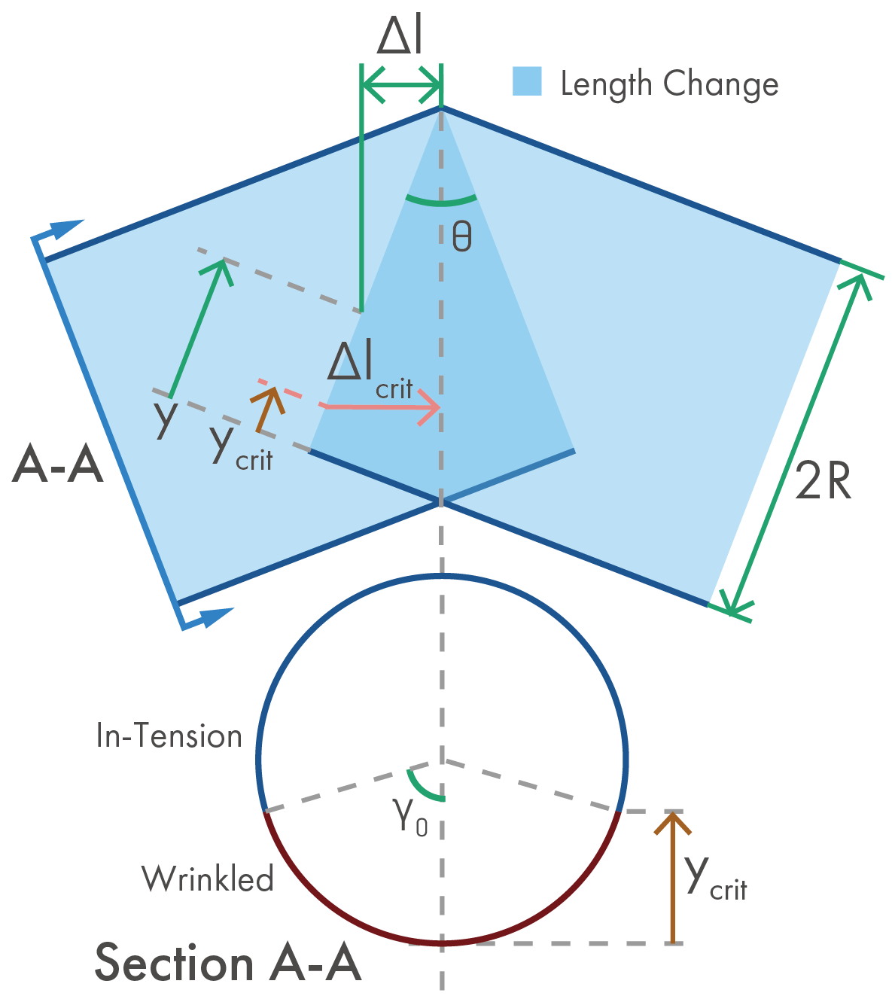
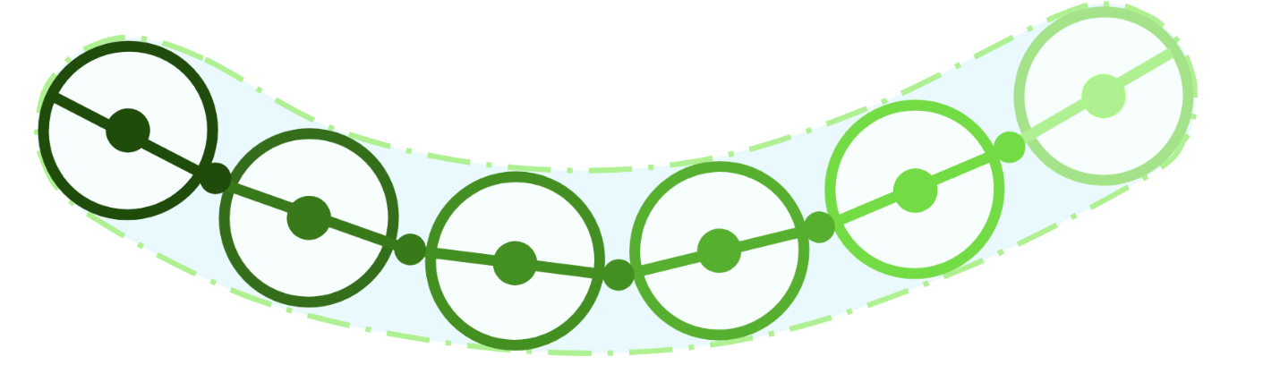
Bending Stiffness Model
New nonlinear bending model
Accurately captures buckling
Fast to compute
Buckling (high bend):
No Buckling (low bend):
Notes:
We know from previous works that linear (or constant) stiffness is not enough to capture buckling behavior. To accurately model this we worked with a mechanical engineering lab, to empirically derive our own nonlinear stiffness model. We used a force transducer blah blah
At low bend angles, even distributed bending along the vine, forming an small but even curve. At high bend angles, taking a high bending angle at one buckling point has a lower total energy than having multiple
small bends. (or point out bend on a vine)
Gives characteristic buckling behavior instead of a smooth curve

Slide 7
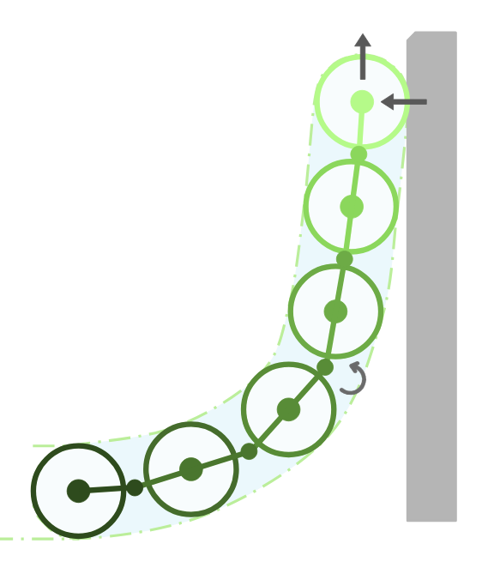
QP solver
3
Finds minimal bending moment under multiple constraints
Uses stiffness function to optimize state
Differentiable — get gradients on vine position with respect to physical parameters and obstacles
1
Collision constraints
Hinge constraint joining bodies
Growth constraint at the tip
2
Notes:
To simulate vine physics realistically, there are complex behaviors that needs to be modelled We express these behaviors as constraints,
Collision constraints (don’t penetrate, slide along obstacle)
Hinge constraint joining consecutive bodies
Growth constraint at the tip
The QP solver must satisfy all these constraints as it generates a feasible next state for the vine.
Within the limitations of the constraints, it finds state with the minimum possible bending energy throughout the vine. Any bending model works, still find optimal solution

Slide 8
Pipeline
Positional Error
Notes:
This frame work, QP solver enables us to perform parameter fitting with real vine data, through its differentiability.
Differentiable simulations have been popular recently
for its versatility and its ability to find gradients between the final output of the simulator and its input parameters. we are able to
propagate gradients from our MSE loss through the QP solver to find the gradient of input parameters that minimize error.

Slide 9
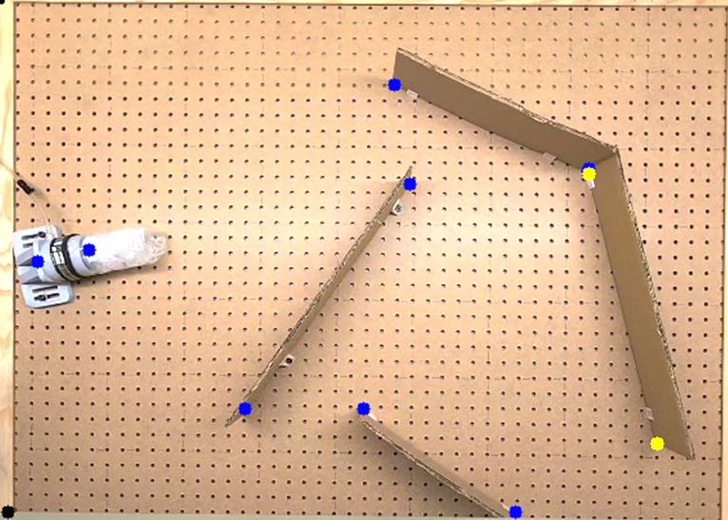
Experiment
Recorded videos of vine in different environments
Used image processing to extract vine position
Compare with simulated vine positions
Notes:
This is how we got the data from our real trials.Training on a single rollout in a single environment is enough for our algorithm. XX
We compare how our sim against real data. And we use it to fit our simulator using our differentiable framework to fit our simulator parameters. We built a real vine robot XX
First we mark the obstacles and where the vine starts in the video. Then we use a video processing algorithm to
locate the vine as it moves in the video. This gets converted to joint positions which match the format we use in the sim.

Slide 10
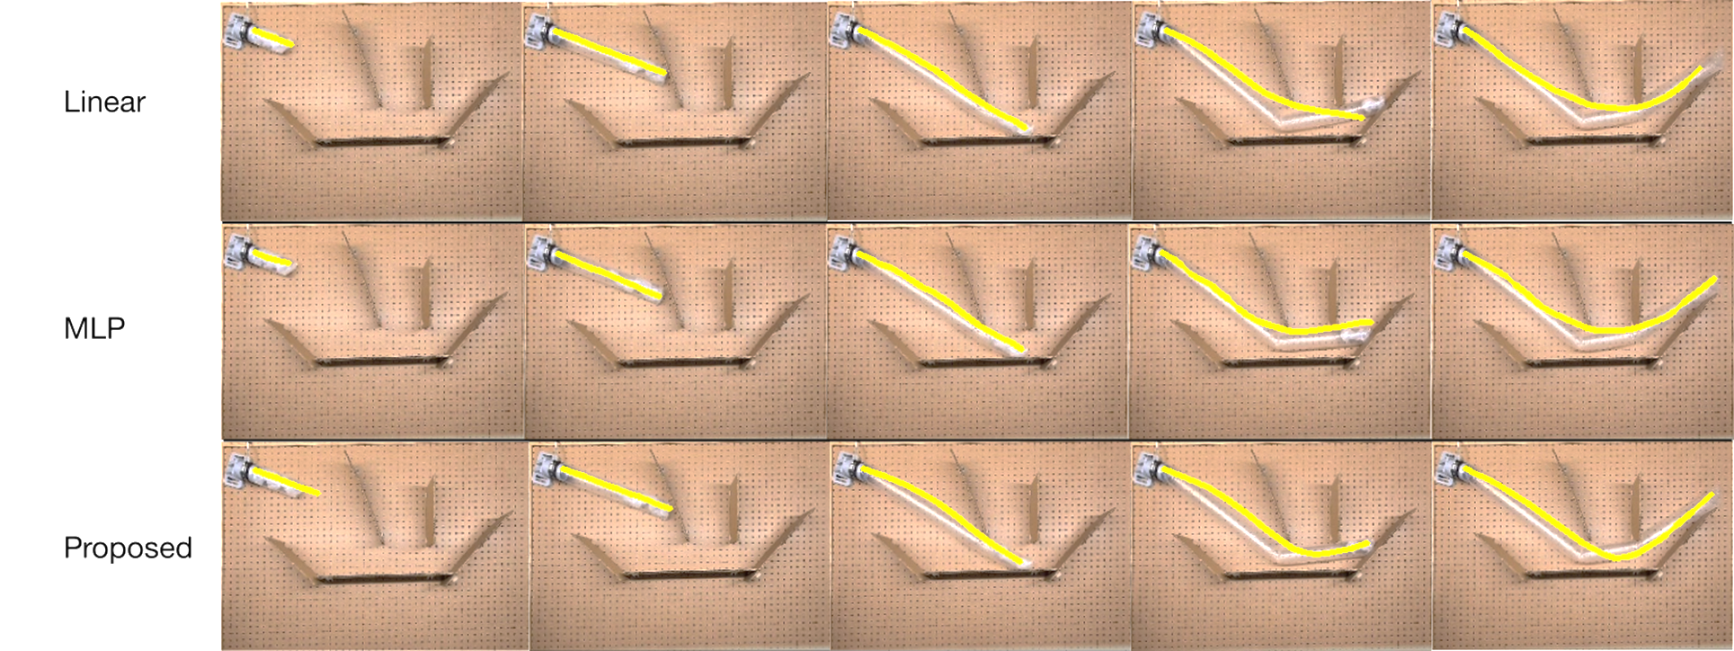
Results
t = 1
t = 2
t = 3
t = 4
t = 5
Linear
MLP
Ours .
Notes:
Here we compare the real videos with the simulator rollouts using three different stiffness models. The linear model doesn’t capture real behavior because it’s flat where the real vine buckles.
The second model uses a stiffness function modeled by an MLP. Because our algorithm is fullydoff we ca. back prop nn. , we can train an MLP using just data as input. In fact, our algorithm will work with any differentiable stiffness function.
Finally, our proposed model captures real behavior the best. The buckles when turning sharp corners like the real vine.

Slide 11
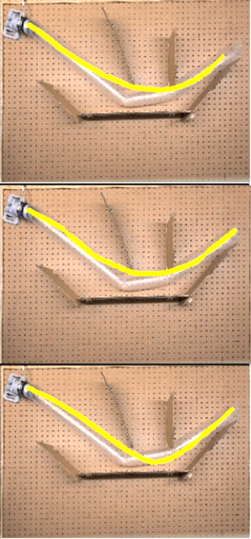
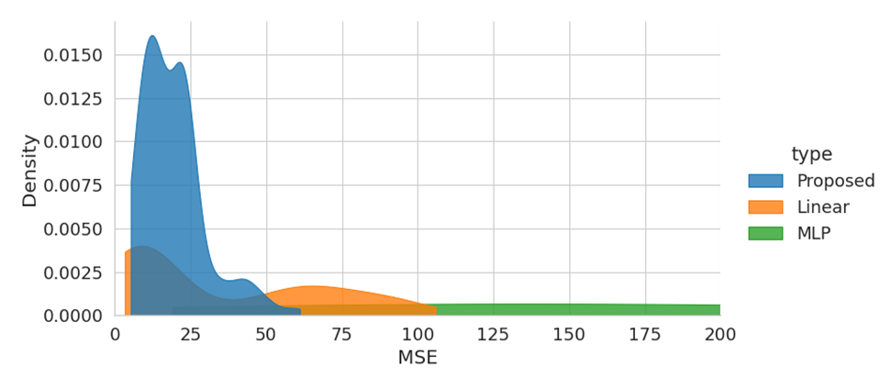
Simulation Accuracy
MSE Loss Between Simulated and Real Position
t = 5
Linear
Density
MLP
.
MSE Loss
Ours .
Notes:
Here we compare the real videos with the simulator rollouts using three different stiffness models. The linear model doesn’t capture real behavior because it’s flat where the real vine buckles.
The second model uses a stiffness function modeled by an MLP. Because our algorithm supports gradients, we can train an MLP using just data as input. In fact, our algorithm will work with any differentiable stiffness function.
Finally, our proposed model captures real behavior the best. The buckles when turning sharp corners like the real vine.

Slide 12
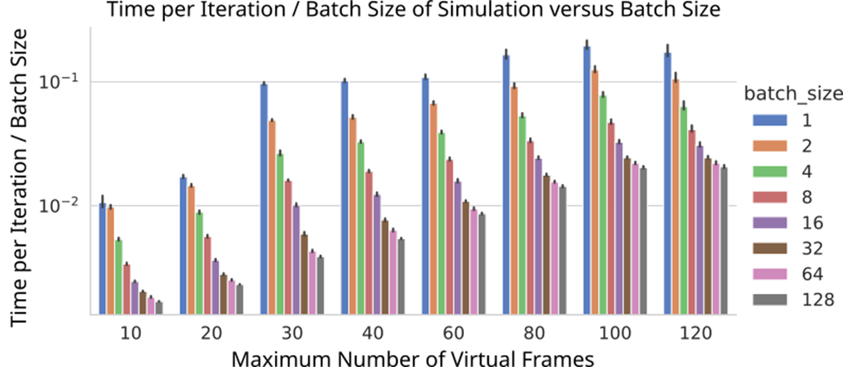
Batching Speed
Able to scale to hundreds of vines in parallel
Benefit from CPU and GPU hardware speedups
Enables for future work in design optimization and planning
Notes:
Because we used Pytorch to develop our simulation framework, we can efficiently process hundreds of vines in parallel.
We usedpytorch to ableto deploy across cpu gpu. .

Slide 13
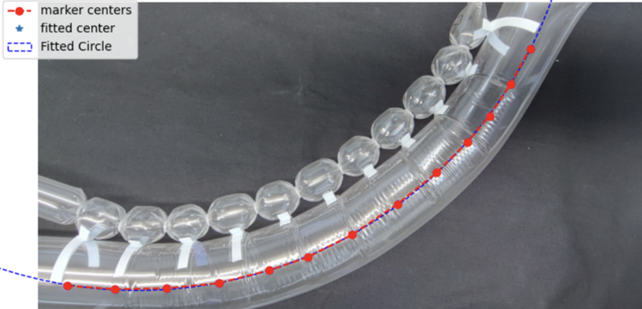
Future work
We use our simulator to produce thousands of rollouts needed for planning tasks
We model actuating vines, which can bend in response to the environment to plan better paths

Slide 14
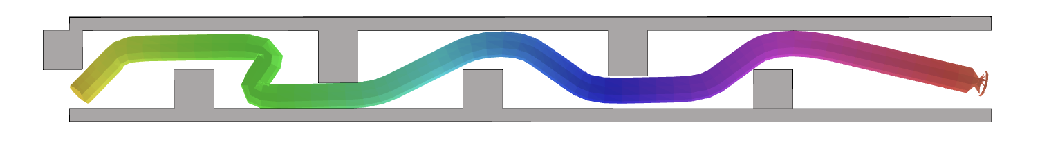


Conclusion
Our custom stiffness model accurately captures buckling behavior
We can simulate hundreds of vines in parallel
We can learn parameters to better fit real data
Foundation for design optimization, planning, and control
Our Lab Website:
commalab.org
Open source code: github.com/CoMMALab/DiffVineSimPy

